Slide 1
Mushroom Classification & XAI approach
MULTI CLASSIFICATION & CONCEPT BOTTLENECK MODEL

Slide 2

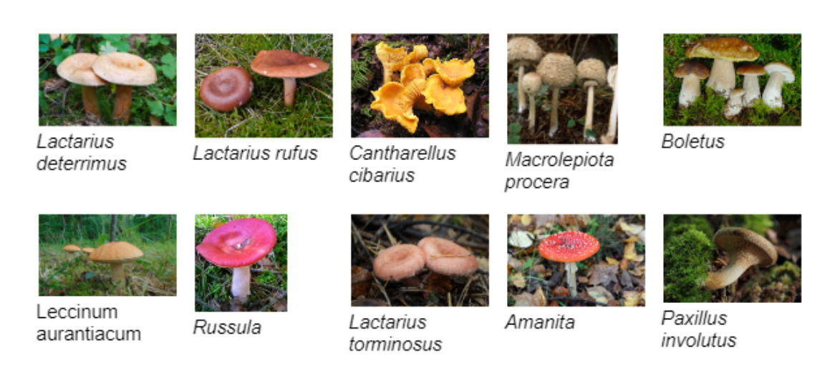

Motivation & Objective
Challenge: Mushroom identification

Slide 3
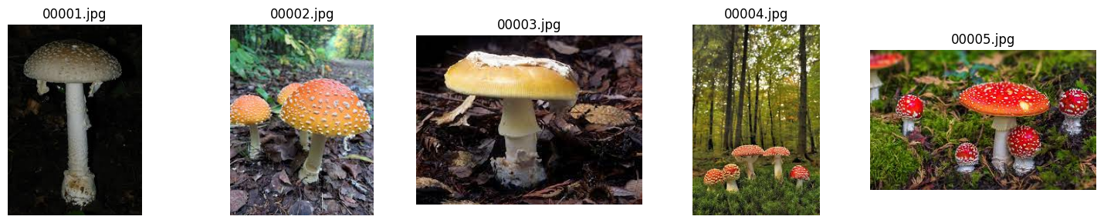
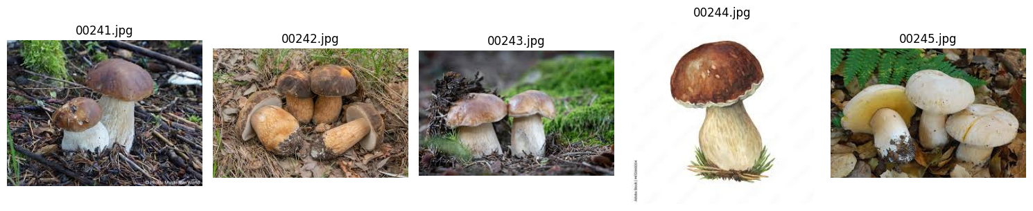
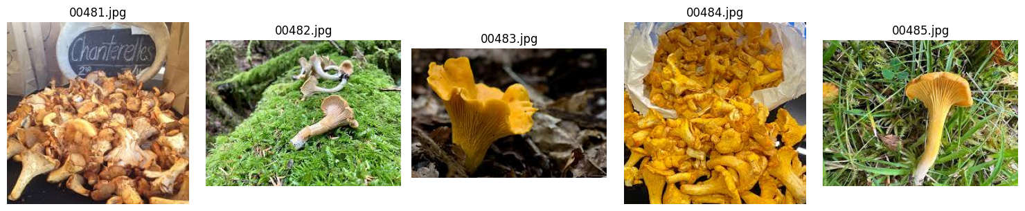
DATASET
Classes:
amanita
boletus
chantelle
deterrimus
rufus
torminosus,
aurantiacum
procera
involutus
russula

Slide 4

Workflow
Data Exploration: Understand data properties
Data Preprocessing: Preperation for training
Baseline Evaluation: AlexNet, ResNet, VGG16, DenseNet, EfficientNet
Finetuning: Evaluation of finetuned baseline models
Custom models: Custom AlexNet & ResNet
Result comparison Reading event files

Slide 5
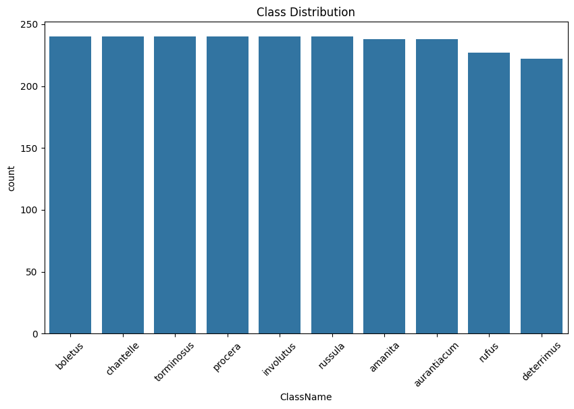
DATASET
Dataset source:
Kaggle – Mushroom Image Classification Dataset
Estonian Dataset
Size:
3000 images total
300 image per class

Slide 6
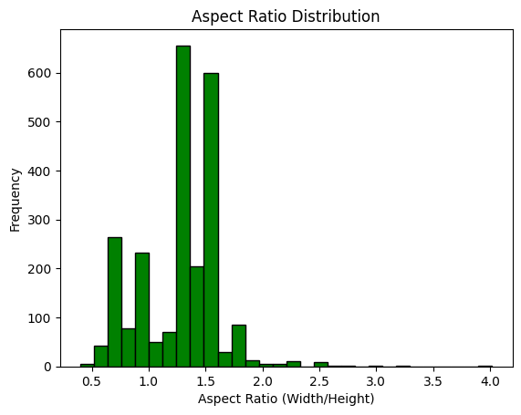
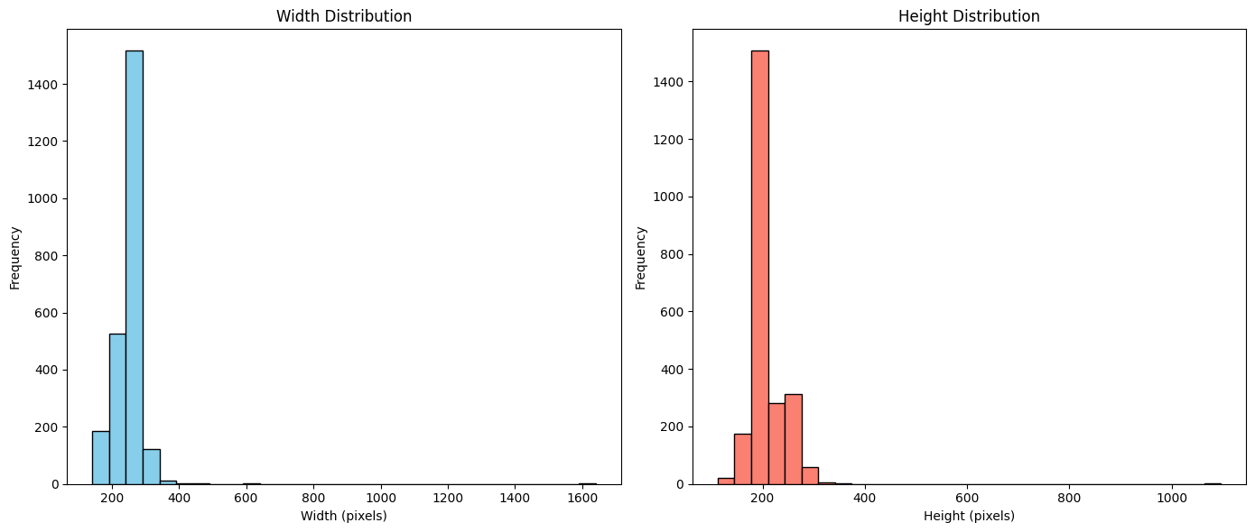
DATA EXPLORATION
Image size and aspect ratio distribution

Slide 7
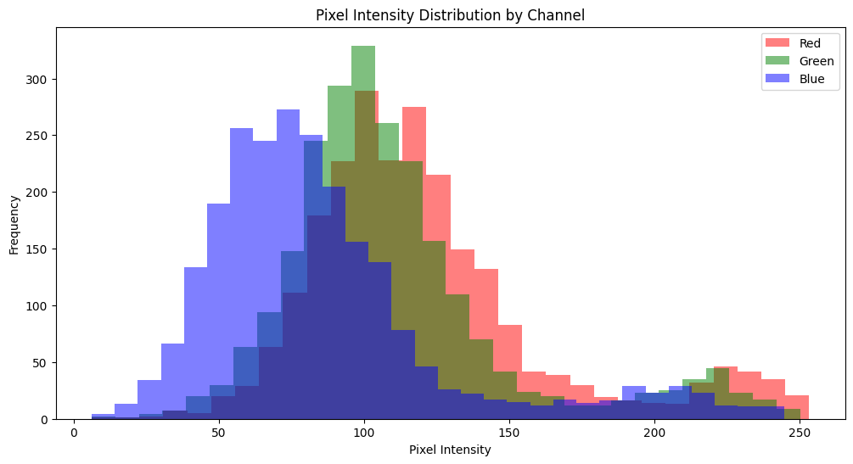
DATA EXPLORATION
Pixel intensity analysis

Slide 8

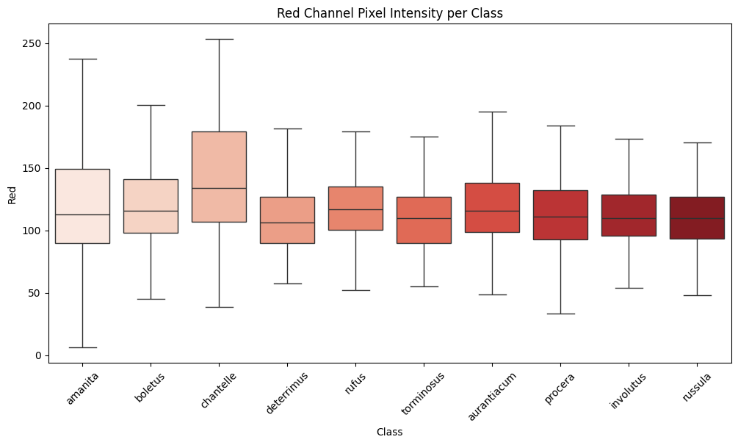
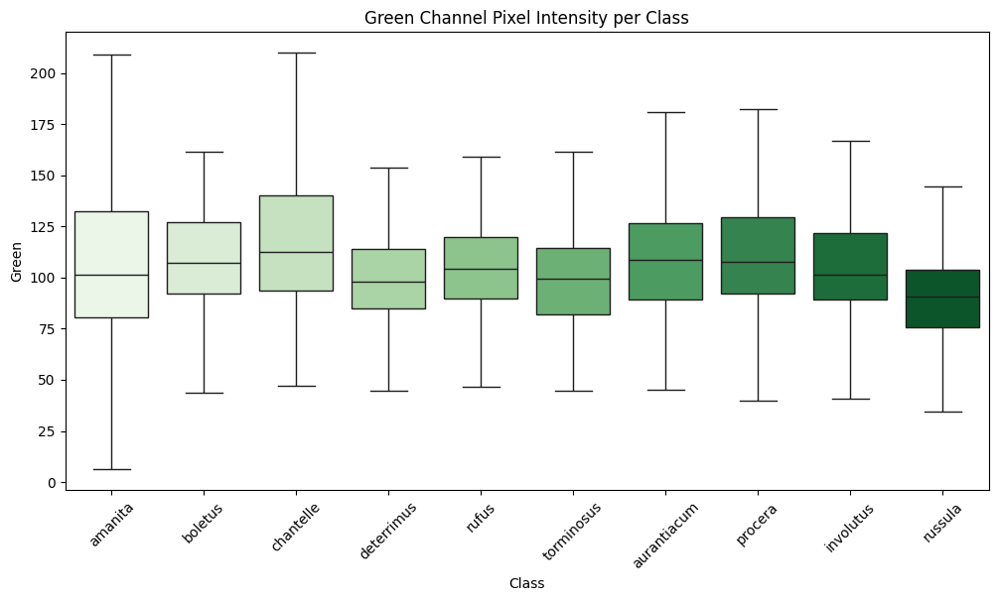
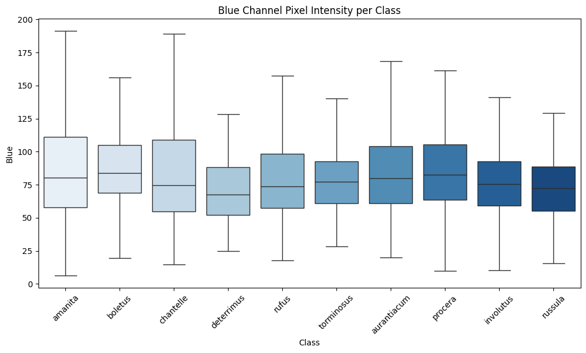



DATA EXPLORATION

Slide 9
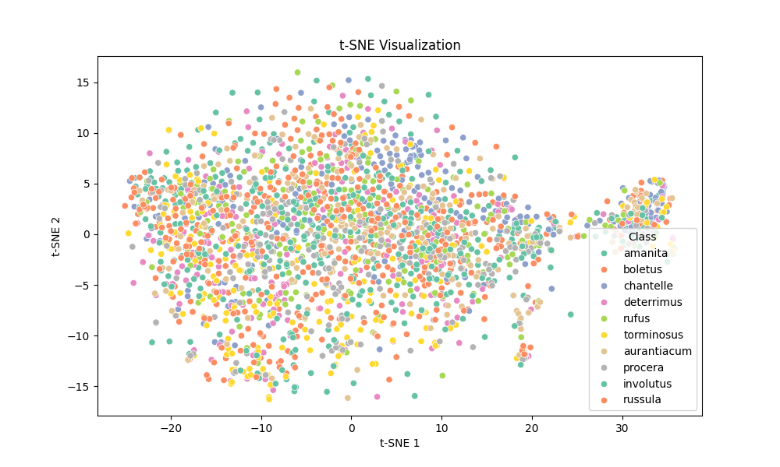
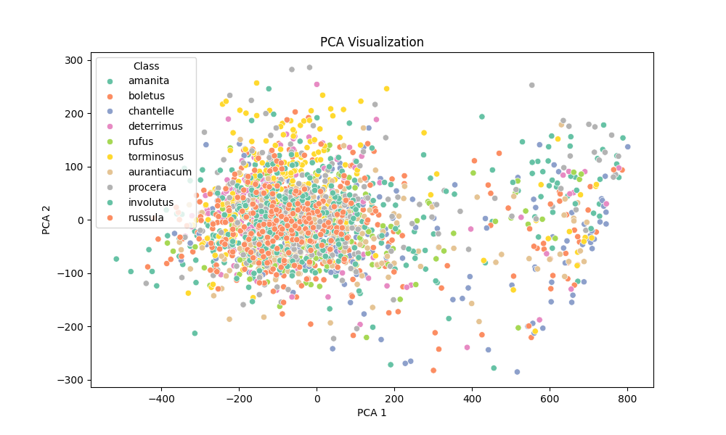
DATA EXPLORATION
Dimensionality Reduction & Clustering on all data & per class
PCA, t-SNE, UMAP
K-Means Clustering

Slide 10
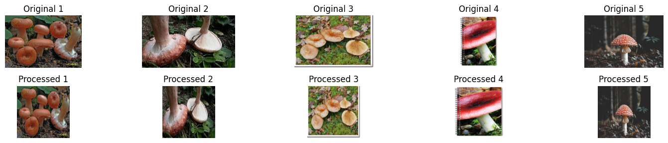
DATA PREPROCESSING
Resizing images: 224x 224px
Normalization

Slide 11
BASELINE MODELS
AlexNet
ResNet
VGG16
DenseNet
EfficientNet

Slide 12
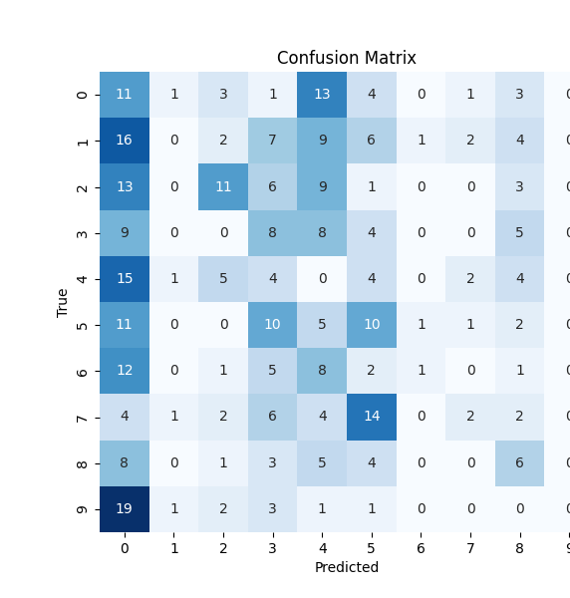
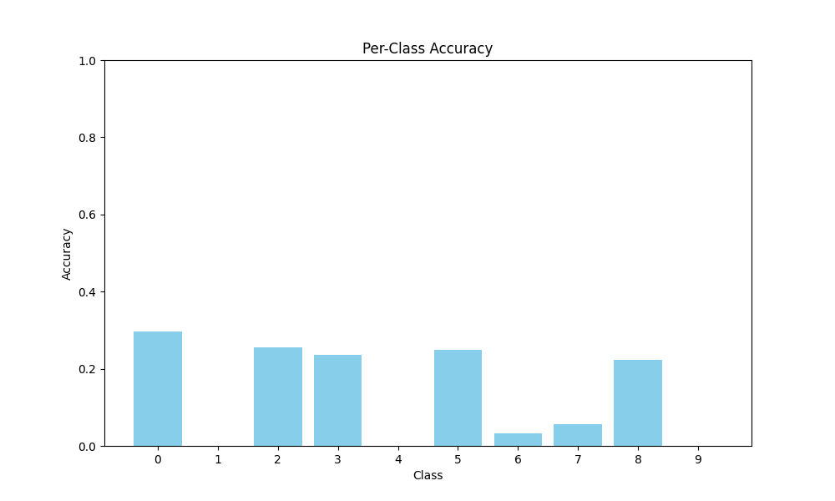
RESULTS – BASELINE EVALUATION

Slide 13
FINETUNED MODELS
Baselines: AlexNet, ResNet, VGG16, DenseNet, EfficientNet
Hyperparameters:
Epochs
Patience (EarlyStopping)
Learning Rate
Scheduler: StepLR, OneCycleLR, None
Optimizer: AdamW
Criterion: CrossEntropyLoss

Slide 14
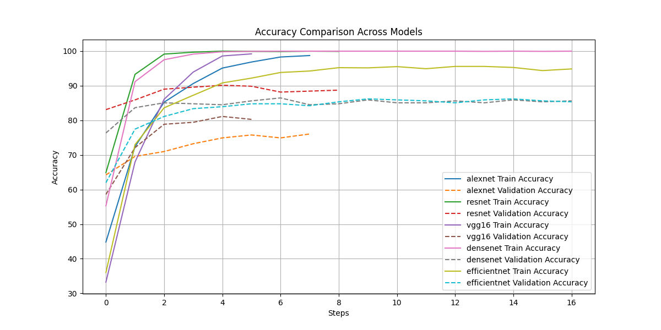
RESULTS – TRAIN / VAL

Slide 15
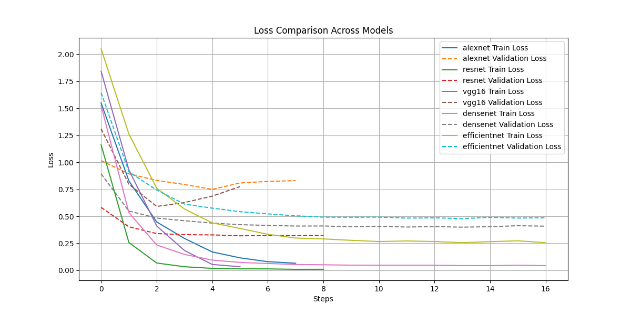
RESULTS – TRAIN / VAL

Slide 16
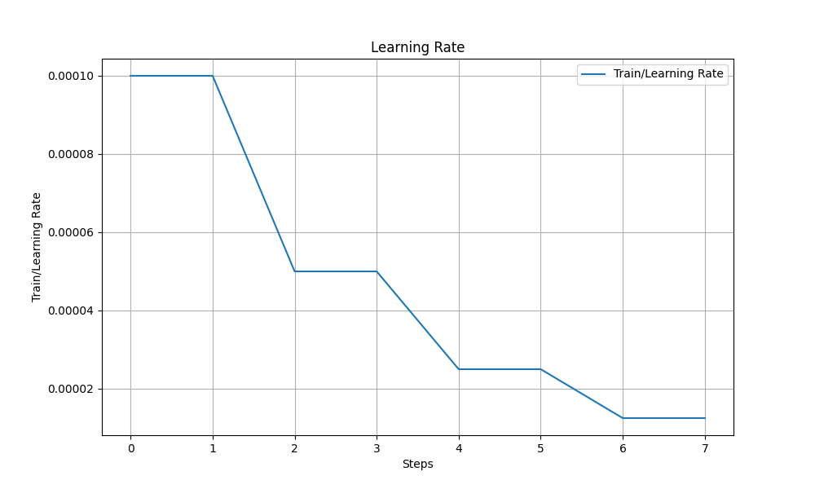
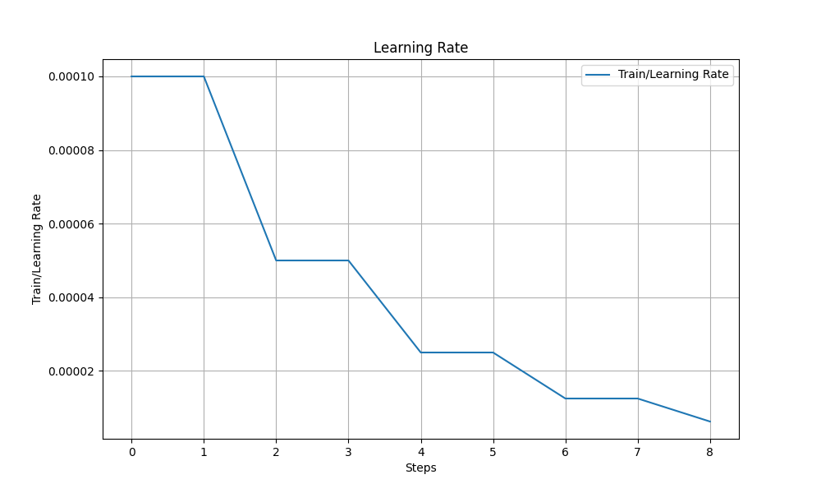
RESULTS – LR TACKING

Slide 17
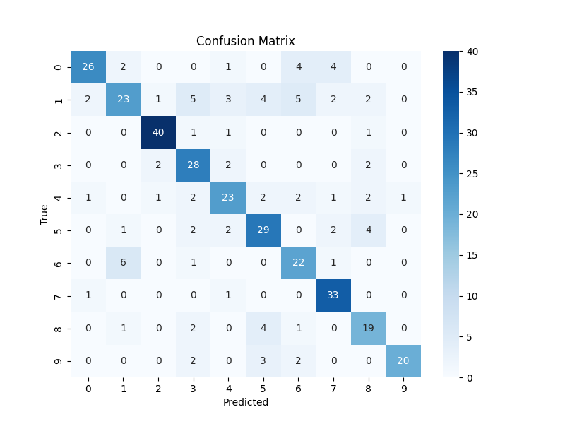
CONFUSION MATRIX – ALEXNET FINETUNED

Slide 18
CONCEPT BOTTLENECK MODEL

